Slide 1
AESOP LLVM and Compiler Benchmarks
Gilroy Gordon, 1101304
Design of Programming Languages
University of Technology, Jamaica

Slide 2
Outline
Introduction
Problem
Solution
Limitations
Compiler “Benchmark” Steps
Demonstration

Slide 3


introduction
Thesis by Dr. Rajeev Barua (2011)
Aims to automatically parallelize serial code through traditional methods
Better than other tools (PLUTO)
Adaptive Environment for Supercompiling
with Optimized Parallelism
Offical Website :
http://aesop.ece.umd.edu

Slide 4
Problem
Moores Law, Increase in the amount of transistors and cores with processors
Inability of Programmers to Optimize and Code in Parallel
Increasing processing needs introduced by problems such as real-time, video and signal processing
Inability to improve compilers with new hardware

Slide 5
Solution
Speed Up of 2.88x SPEC2006
Integration with already built tools such as LLVM, CLANG and DRAGONEGG
Traditional Affine Parallelization on IR received from LLVM
Utilizing System Characterization and Artificial Intelligence to created a generic and optimized solution

Slide 6
Solution
Automatic parallelization of sequential code enabled more than ten (10) times productivity for the software life cycle.
Heuristics involved achieved an increase of 20% in performance.
The design combines the aforementioned elements seamlessly adapting codes to new hardware systems with zero modifications.
From tests cited at the University of Maryland, after analyzing benchmarks compiled on an AMD Opteron™ 6212 a speedup of 1.88X was achieved on all benchmarks

Slide 7
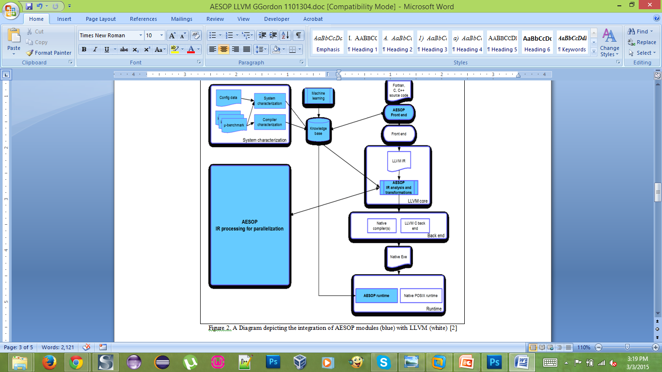
Solution

Slide 8
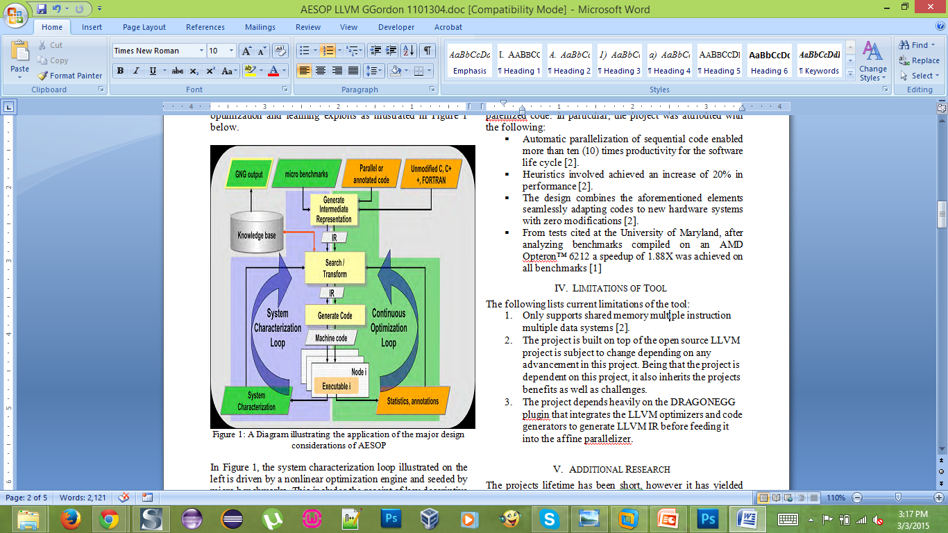
Solution

Slide 9
Limitations
Supports shared memory multiple instruction multiple data systems
Depends on CLANG
Depends on DragonEgg
Due to the use of traditional methods, unable to model dependencies between every dynamic instance within loops

Slide 10
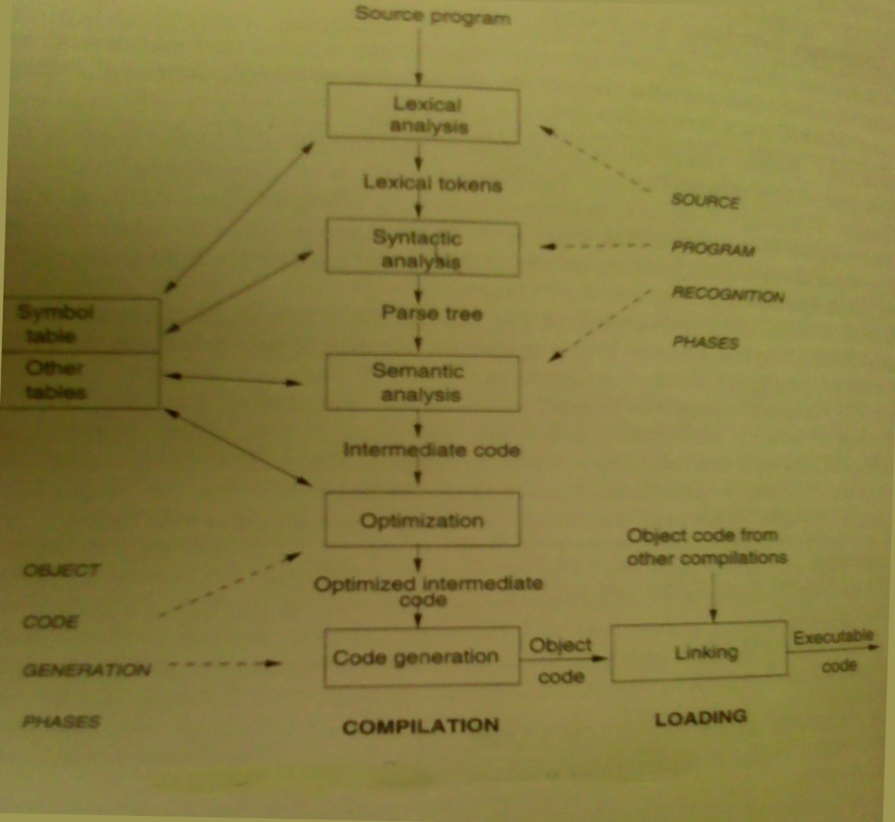
Compiler “BenchMark” Steps

Slide 11
Compiler “Benchmark” steps
Considering CLANG
5 Core Libraries
Basic, Lex, Parse, AST, SEMA
Step 1: Lexer creates lexems (preprocessor directives are handled on arrival)
Directives added to Symbol Table
Step 2: Parser creates AST
Verifies with Symbol and Identifier Table
Uses DeclContext (Class Definition)
Clang accomodates overloading with Argument Dependent Lookup

Slide 12
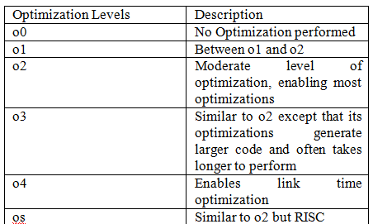
Compiler “Benchmark” steps - Optimization

Slide 13
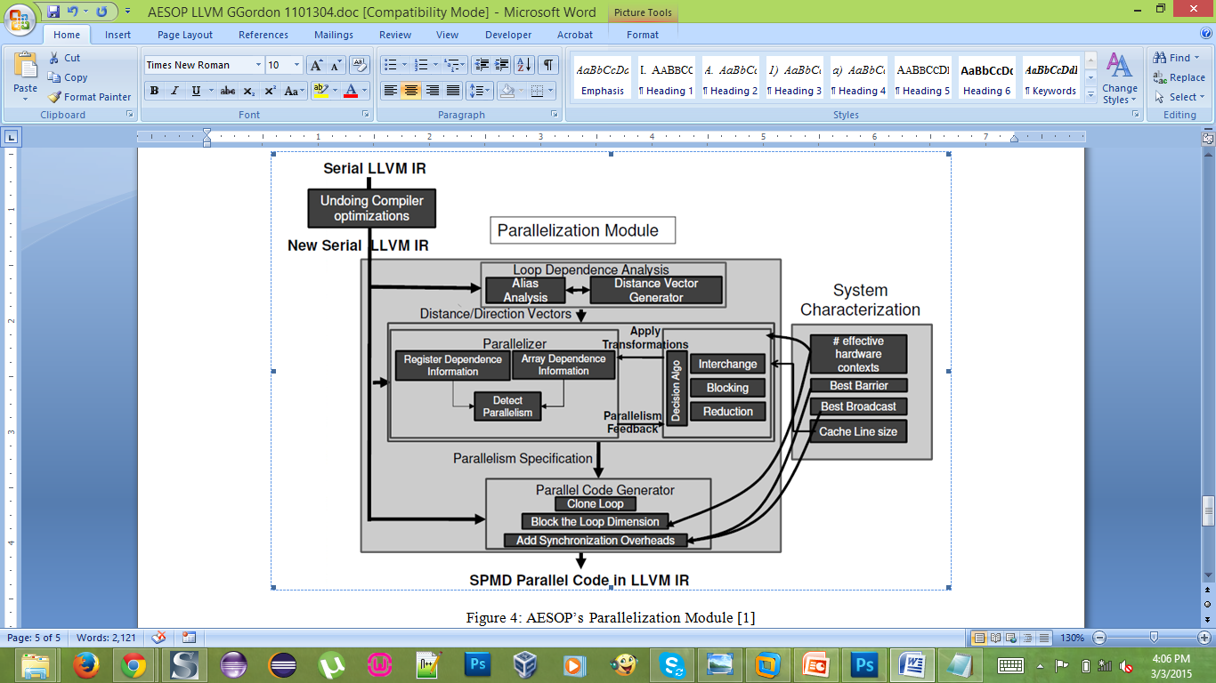
Compiler “Benchmark” Steps - Optimization

Slide 15
References
R. Barua, T. Creech and A. Kotha, 'AESOP: The Autoparallelizing Compiler for Shared Memory Computers', Doctorate, University of Maryland, College Park, 2011.
Defense Advanced Research Projects Agency/ Information Processing Techniques Office, 'ADAPTIVE ENVIRONMENT FOR SUPERCOMPILING WITH OPTIMIZED PARALLELISM (AESOP)', BAE Systems, Inc., Guildford, UK, 2011.
D. Watson, High-level languages and their compilers. Wokingham, England: Addison-Wesley, 1989.
S. Naroff, 'Clang Intro', Apple[sn], 2015.
C. Guntli, 'Architecture of clang: Analyze an open source compiler based on LLVM', University of Applied Science in Rapperswil, 2011.
Clang.llvm.org, 'Clang Compiler User’s Manual — Clang 3.7 documentation', 2015. [Online]. Available: http://clang.llvm.org/docs/UsersManual.html. [Accessed: 27- Feb- 2015].

Slide 16
Demonstration
The associated tutorial for this demonstration may be found at:
https://github.com/gggordon/aesop-llvm

Slide 17

Questions

Slide 18

Thank You

